Slide 1
Union-Find

Slide 2
Design an algorithm that can perform the following operations:
1) Make-Singleton(u): Make a single node u
2)Union(u,v): Add edge (u,v)
3)Find(u): Return the unique identifier of the tree that
contains u

Slide 3
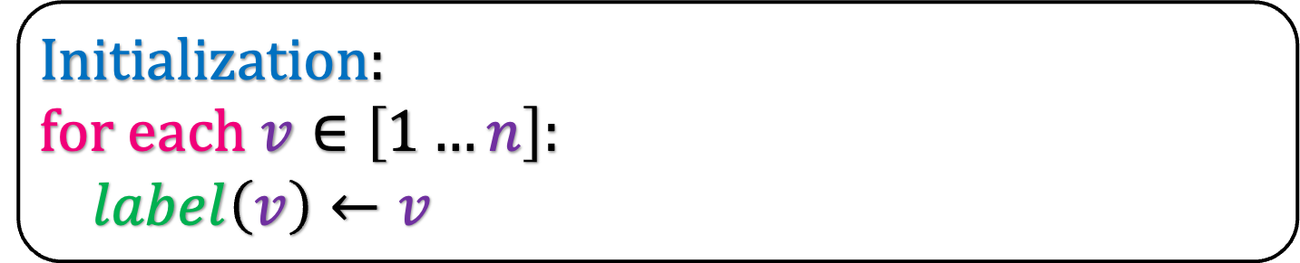
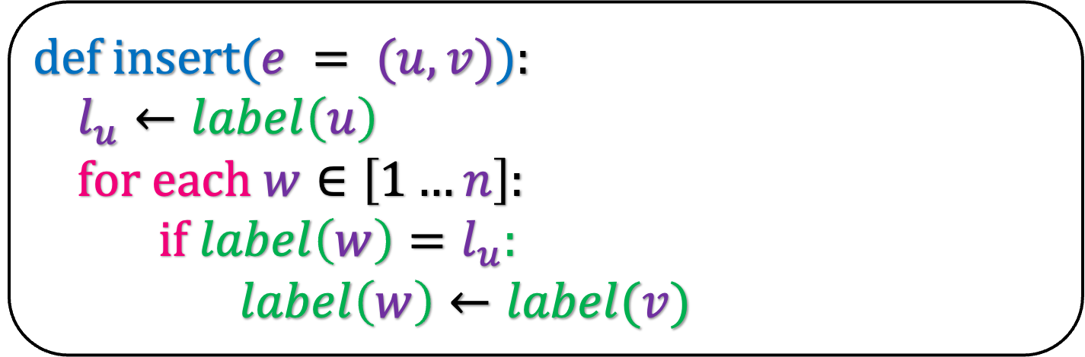
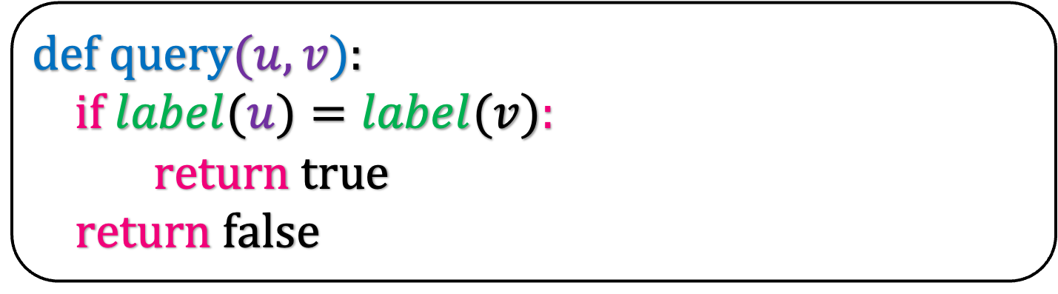
Initialization:
for each $v∈\left[1…n\right]:$
$label\left(v\right)←v$
def insert($e = (u,v)$):
$l_{u}←label\left(u\right)$
for each $w∈\left[1…n\right]:$
if $label\left(w\right)=l_{u}:$
$label\left(w\right)←label(v)$
Remember that we designed the following data-structure for Kruskal’s algorithm
def query$(u,v$):
if $label(u)=label(v):$
return true
return false

Slide 4
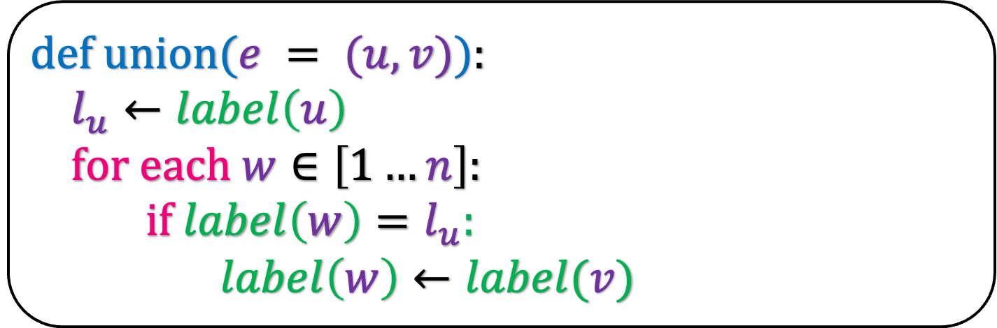

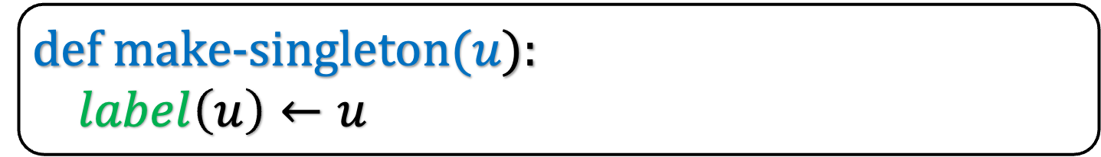


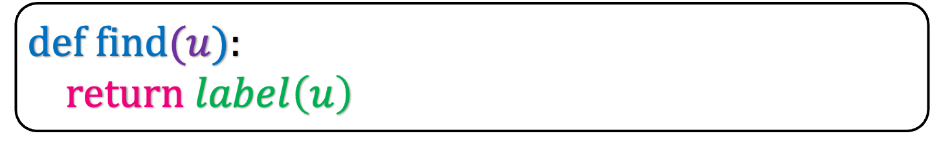
def make-singleton($u$):
$label\left(u\right)←u$
O($1$)
def union($e = (u,v)$):
$l_{u}←label\left(u\right)$
for each $w∈\left[1…n\right]:$
if $label\left(w\right)=l_{u}:$
$label\left(w\right)←label(v)$
We make cosmetic changes to them to solve the union-find problem.
O($n$)
def find$(u$):
return $label\left(u\right)$
O($1$)
Can we decrease the time of union?

Slide 5
4
We will create a label array.
Intially each node is a singleton
1
1
1
What shold be the label for node 1?
2
6
5
3
Label

Slide 6
4
4
We will create a label array.
Intially each node is a singleton
1
1
What shold be the label for node 1?
2
2
6
6
5
5
3
3
Label
1
1

Slide 7
4
1
1
2
6
5
3
Label
1
2
3
4
5
6
2
3
4
5
6

Slide 8
4
What should you do if the edge (1,2) is added?
1
1
Change the label of 1 or 2.
2
6
5
3
Label
1
2
3
4
5
6

Slide 9
4
What should you do if the edge (1,2) is added?
1
1
Change the label of 1 or 2.
2
6
5
3
Label
1
1
3
4
5
6

Slide 10
4
What should you do if the edge (2,5) is added?
1
1
Change the label of 5 not [2,1].
2
6
5
3
Label
1
1
3
4
5
6

Slide 11
4
What should you do if the edge (2,5) is added?
1
1
Change the label of 5 not [2,1].
2
6
5
3
Label
1
1
3
4
1
6

Slide 12
4
What should you do if the edge (4,6) is added?
1
1
Change the label of 4 or 6.
2
6
5
3
Label
1
1
3
4
1
6

Slide 13
4
What should you do if the edge (4,6) is added?
1
1
Change the label of 4 or 6.
2
6
5
3
Label
1
1
3
4
1
4

Slide 14
4
What should you do if the edge (5,6) is added?
1
1
Change the label of [4,6] not [1,2,5].
2
6
5
3
Label
1
1
3
4
1
4

Slide 15
4
What should you do if the edge (5,6) is added?
1
1
Change the label of [4,6] not [1,2,5].
2
Main Observation: Change the labels of nodes in the smaller tree.
6
5
3
Label
1
1
3
1
1
1

Slide 16
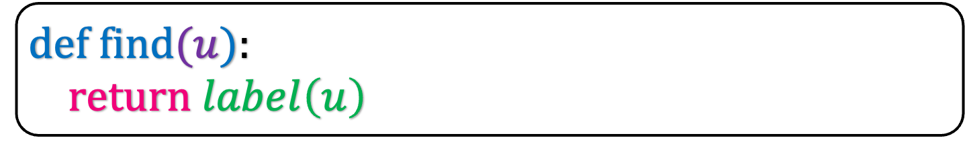
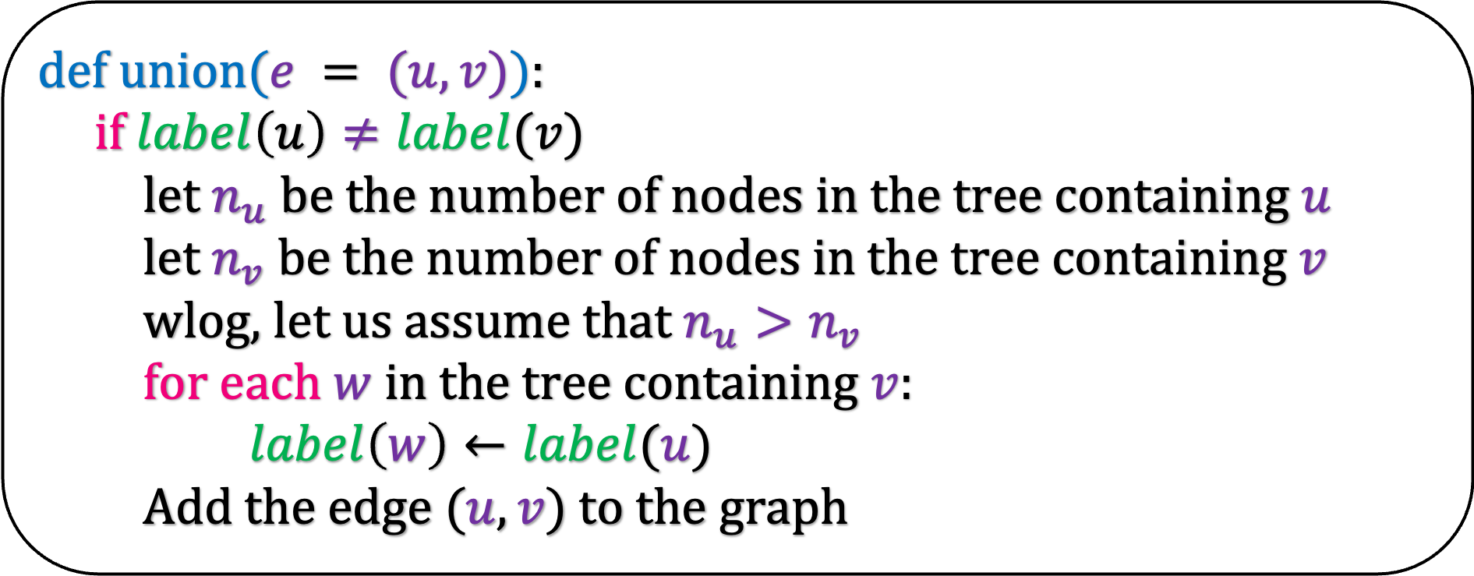


But how do you find $n_{u}$ and $n_{v}$?
def make-singleton($u$):
$label\left(u\right)←u$
def union($e = (u,v)$):
if $label\left(u\right)≠label(v)$
let $n_{u}$ be the number of nodes in the tree containing $u$
let $n_{v}$ be the number of nodes in the tree containing $v$
wlog, let us assume that $n_{u}>n_{v}$
for each $w$ in the tree containing $v$:
$label\left(w\right)←label(u)$
Add the edge $(u,v)$ to the graph
def find$(u$):
return $label\left(u\right)$

Slide 17
5
1
2
6
4
3

Slide 18
5
Union(4,5)
1
Do a BFS from 4 and 5 in parallel before adding the edge (4,5)
2
6
4
3

Slide 19
5
Union(4,5)
1
Do a BFS from 4 and 5 in parallel before adding the edge (4,5)
2
6
4
3

Slide 20
5
Union(4,5)
1
Do a BFS from 4 and 5 in parallel before adding the edge (4,5)
The BFs from node 5 finishes first
2
This implies that the tree containing 5 has less number of nodes.
6
4
3

Slide 21
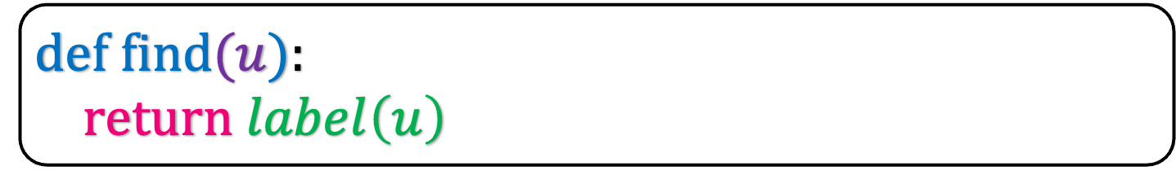
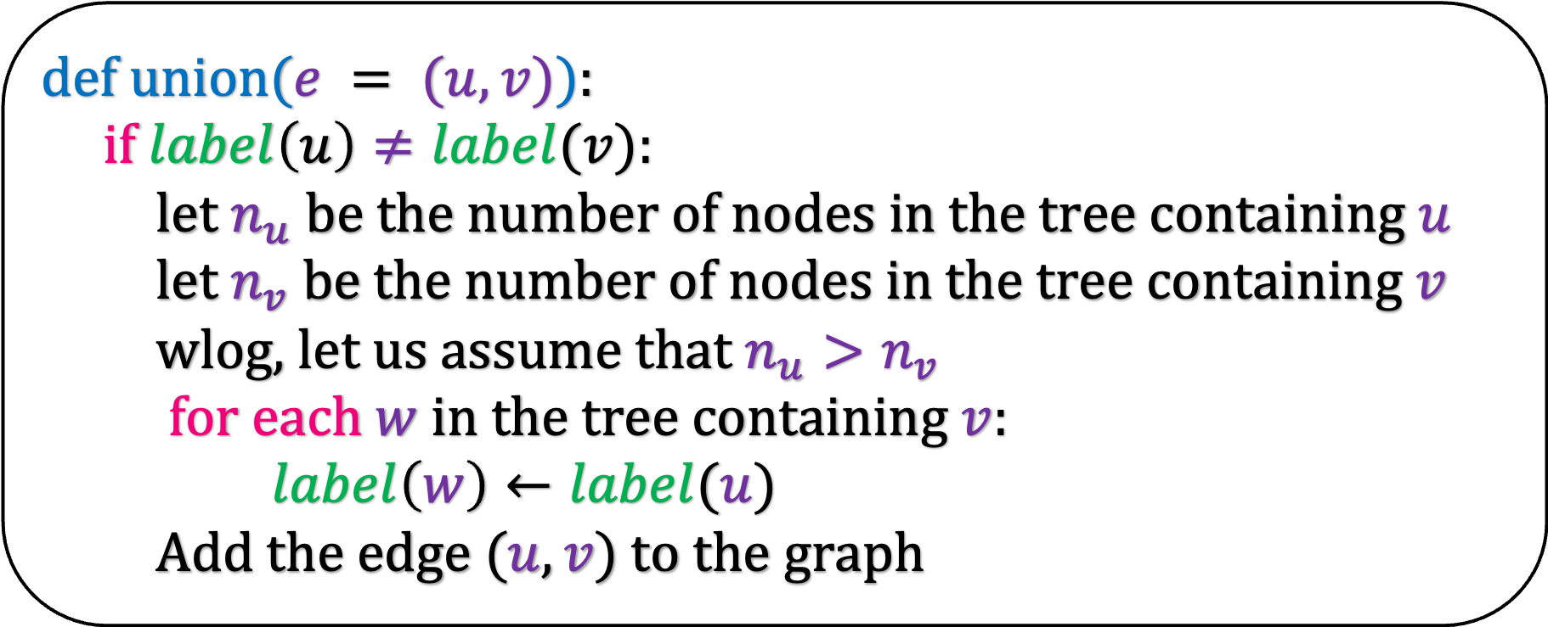
def make-singleton($u$):
$label\left(u\right)←u$
def union($e = (u,v)$):
if $label\left(u\right)≠label(v)$:
let $n_{u}$ be the number of nodes in the tree containing $u$
let $n_{v}$ be the number of nodes in the tree containing $v$
wlog, let us assume that $n_{u}>n_{v}$
for each $w$ in the tree containing $v$:
$label\left(w\right)←label(u)$
Add the edge $(u,v)$ to the graph
def find$(u$):
return $label\left(u\right)$

Slide 22
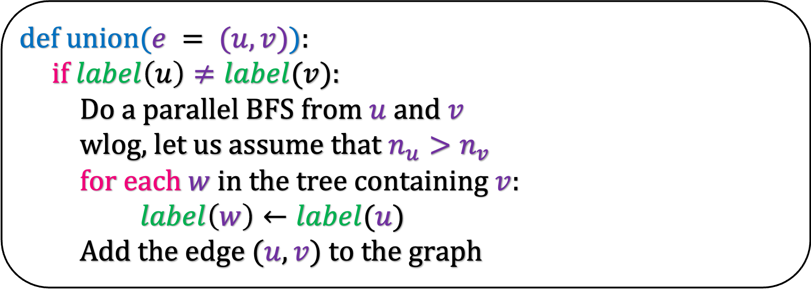
def make-singleton($u$):
$label\left(u\right)←u$
def union($e = (u,v)$):
if $label\left(u\right)≠label(v)$:
Do a parallel BFS from $u$ and $v$
wlog, let us assume that $n_{u}>n_{v}$
for each $w$ in the tree containing $v$:
$label\left(w\right)←label(u)$
Add the edge $(u,v)$ to the graph
def find$(u$):
return $label\left(u\right)$

Slide 23
def make-singleton($u$):
$label\left(u\right)←u$
def union($e = (u,v)$):
if $label\left(u\right)≠label(v)$:
Do a parallel BFS from $u$ and $v$
wlog, let us assume that $n_{u}>n_{v}$
for each $w$ in the tree containing $v$:
$label\left(w\right)←label(u)$
Add the edge $(u,v)$ to the graph
def find$(u$):
return $label\left(u\right)$

Slide 24
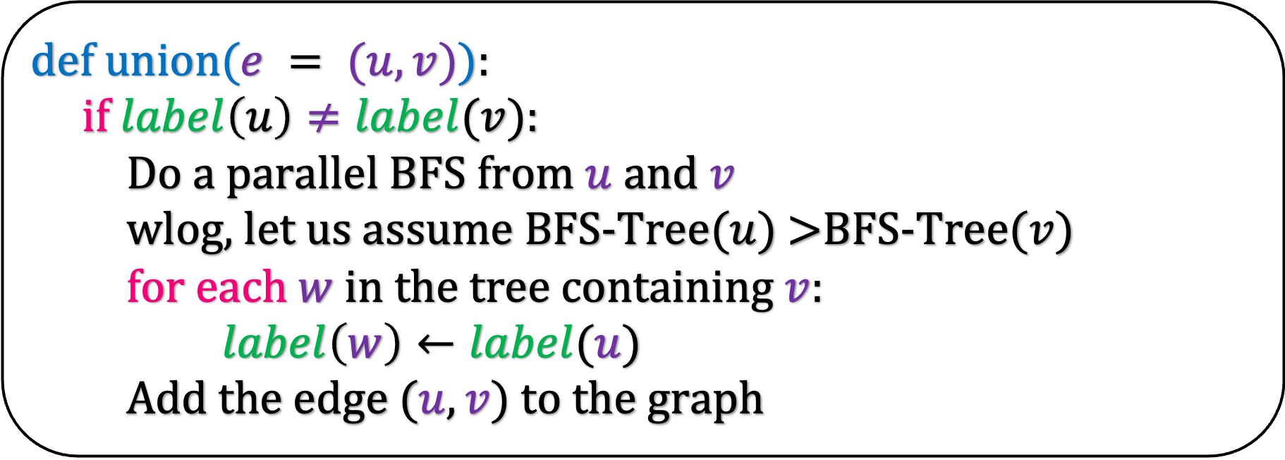
def make-singleton($u$):
$label\left(u\right)←u$
def union($e = (u,v)$):
if $label\left(u\right)≠label(v)$:
Do a parallel BFS from $u$ and $v$
wlog, let us assume BFS-Tree($u$) >BFS-Tree($v$)
for each $w$ in the tree containing $v$:
$label\left(w\right)←label(u)$
Add the edge $(u,v)$ to the graph
def find$(u$):
return $label\left(u\right)$

Slide 25
def make-singleton($u$):
$label\left(u\right)←u$
def union($e = (u,v)$):
if $label\left(u\right)≠label(v)$:
Do a parallel BFS from $u$ and $v$
wlog, let us assume BFS-Tree($u$) >BFS-Tree($v$)
for each $w$ in the tree containing $v$:
$label\left(w\right)←label(u)$
Add the edge $(u,v)$ to the graph
def find$(u$):
return $label\left(u\right)$

Slide 26
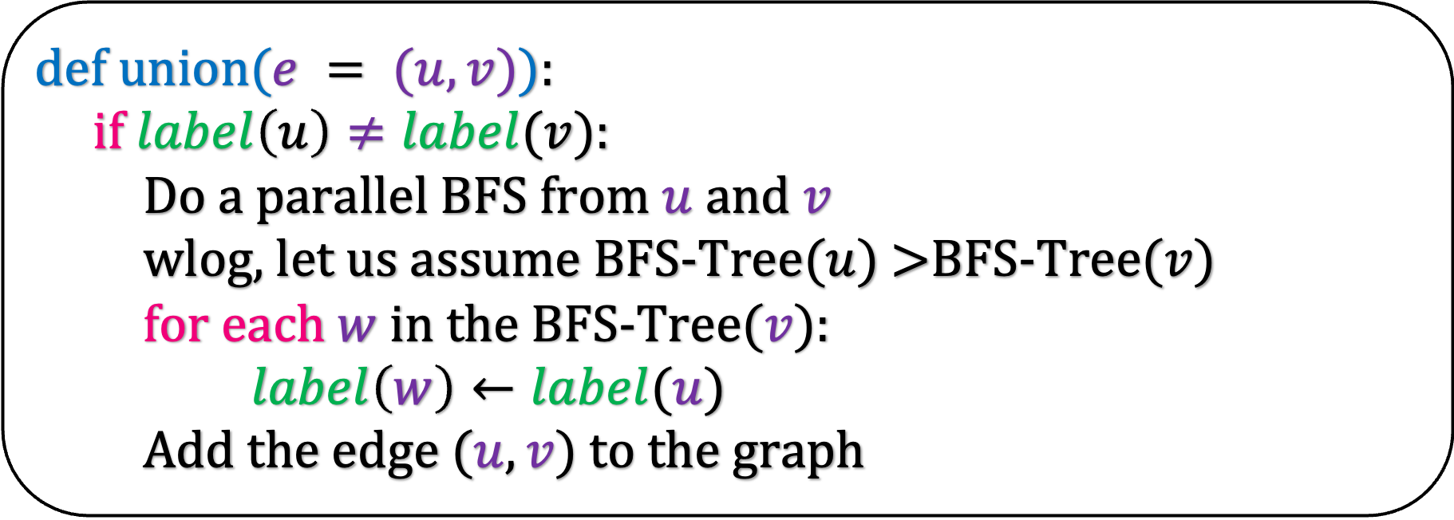
def make-singleton($u$):
$label\left(u\right)←u$
def union($e = (u,v)$):
if $label\left(u\right)≠label(v)$:
Do a parallel BFS from $u$ and $v$
wlog, let us assume BFS-Tree($u$) >BFS-Tree($v$)
for each $w$ in the BFS-Tree($v$):
$label\left(w\right)←label(u)$
Add the edge $(u,v)$ to the graph
def find$(u$):
return $label\left(u\right)$

Slide 27
What is the running time of union?
def make-singleton($u$):
$label\left(u\right)←u$
def union($e = (u,v)$):
if $label\left(u\right)≠label(v)$:
Do a parallel BFS from $u$ and $v$
wlog, let us assume BFS-Tree($u$) >BFS-Tree($v$)
for each $w$ in the BFS-Tree($v$):
$label\left(w\right)←label(u)$
Add the edge $(u,v)$ to the graph
O(#nodes+#edges in tree containing v)
def find$(u$):
return $label\left(u\right)$

Slide 28

What is the running time of union?
def make-singleton($u$):
$label\left(u\right)←u$
def union($e = (u,v)$):
if $label\left(u\right)≠label(v)$:
Do a parallel BFS from $u$ and $v$
wlog, let us assume BFS-Tree($u$) >BFS-Tree($v$)
for each $w$ in the BFS-Tree($v$):
$label\left(w\right)←label(u)$
Add the edge $(u,v)$ to the graph
O($n_{v}+n_{v}−1$)
def find$(u$):
return $label\left(u\right)$

Slide 29


What is the running time of union?
def make-singleton($u$):
$label\left(u\right)←u$
def union($e = (u,v)$):
if $label\left(u\right)≠label(v)$:
Do a parallel BFS from $u$ and $v$
wlog, let us assume BFS-Tree($u$) >BFS-Tree($v$)
for each $w$ in the BFS-Tree($v$):
$label\left(w\right)←label(u)$
Add the edge $(u,v)$ to the graph
O($n_{v}$)
O($n_{v}$)
def find$(u$):
return $label\left(u\right)$

Slide 30

What is the running time of union?
def make-singleton($u$):
$label\left(u\right)←u$
def union($e = (u,v)$):
if $label\left(u\right)≠label(v)$:
Do a parallel BFS from $u$ and $v$
wlog, let us assume BFS-Tree($u$) >BFS-Tree($v$)
for each $w$ in the BFS-Tree($v$):
$label\left(w\right)←label(u)$
Add the edge $(u,v)$ to the graph
O($n_{v}$)
def find$(u$):
return $label\left(u\right)$

Slide 31
What is the running time of union?
def make-singleton($u$):
$label\left(u\right)←u$
def union($e = (u,v)$):
if $label\left(u\right)≠label(v)$:
Do a parallel BFS from $u$ and $v$
wlog, let us assume BFS-Tree($u$) >BFS-Tree($v$)
for each $w$ in the BFS-Tree($v$):
$label\left(w\right)←label(u)$
Add the edge $(u,v)$ to the graph
The number of nodes that have changed their labels
def find$(u$):
return $label\left(u\right)$

Slide 32
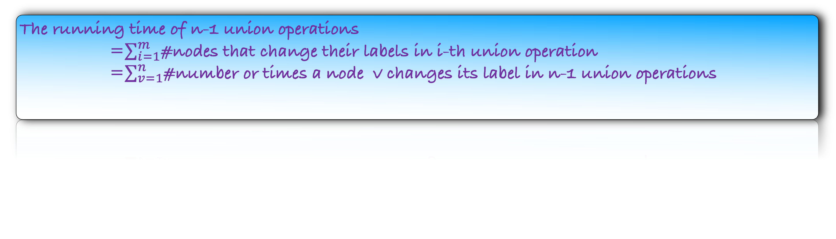
The running time of n-1 union operations
=$∑_{i=1}^{m}$#nodes that change their labels in i-th union operation
=$∑_{v=1}^{n}$#number or times a node v changes its label in n-1 union operations
How many times can a vertex change its label?

Slide 33
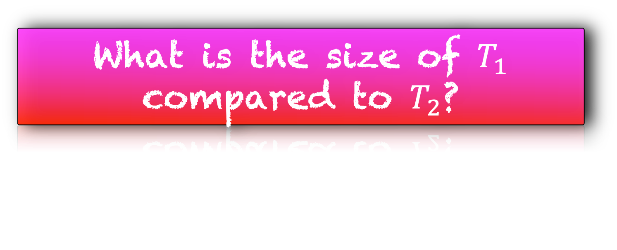

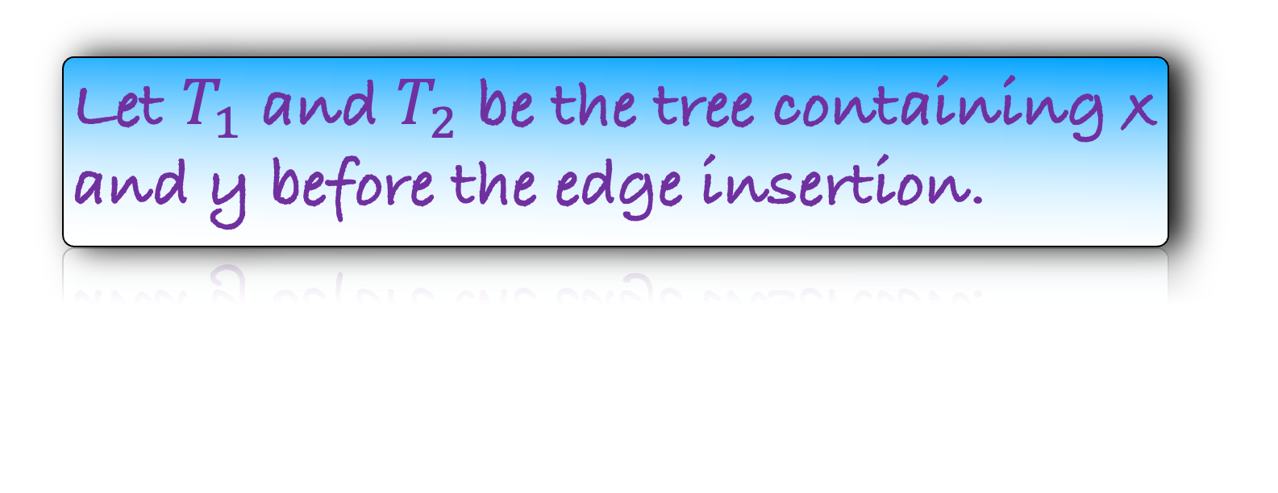

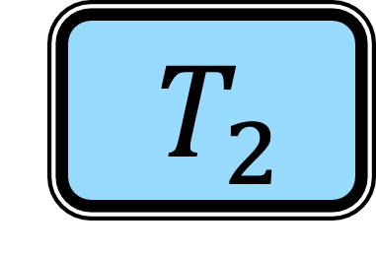


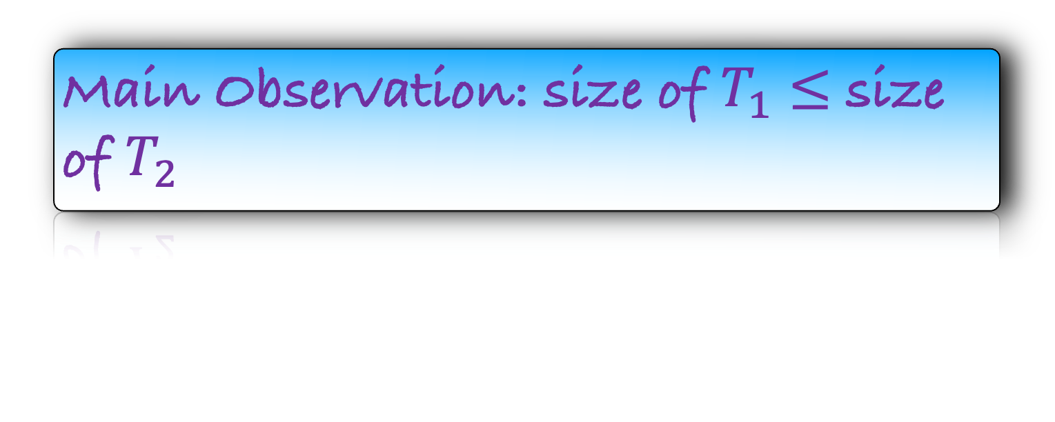
Suppose v changes its label after addition of an edge, say (x,y)
Let $T_{1}$ and $T_{2}$ be the tree containing x and y before the edge insertion.
$$v$$
What is the size of $T_{1}$ compared to $T_{2}$?
$$y$$
$$T_{1}$$
$$x$$
Main Observation: size of $T_{1}$ $≤$ size of $T_{2}$
$$T_{2}$$

Slide 34


Suppose v changes its label after addition of an edge, say (x,y)
Let $T_{1}$ and $T_{2}$ be the tree containing x and y before the edge insertion.
$$v$$
What is the size of $T_{1}$ compared to $T_{2}$?
$$y$$
Main Observation: size of $T_{1}$ $≤$ size of $T_{2}$
$$T$$
$$x$$
After the edge insertion, the tree containing v doubles in size.
Lemma: After v changes its label, the tree containing it doubles in size

Slide 35
Lemma: After v changes its label, the tree containing it doubles in size
How many times can v change its label?
$$\log{n}$$

Slide 36

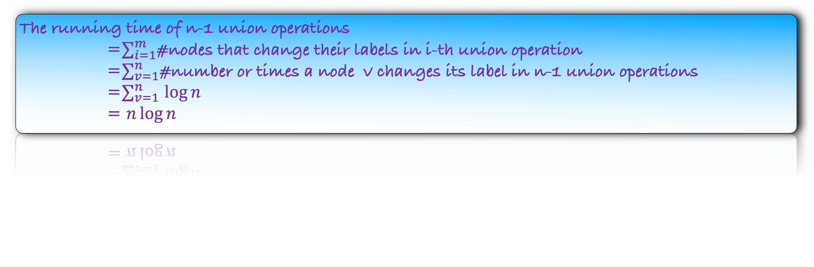
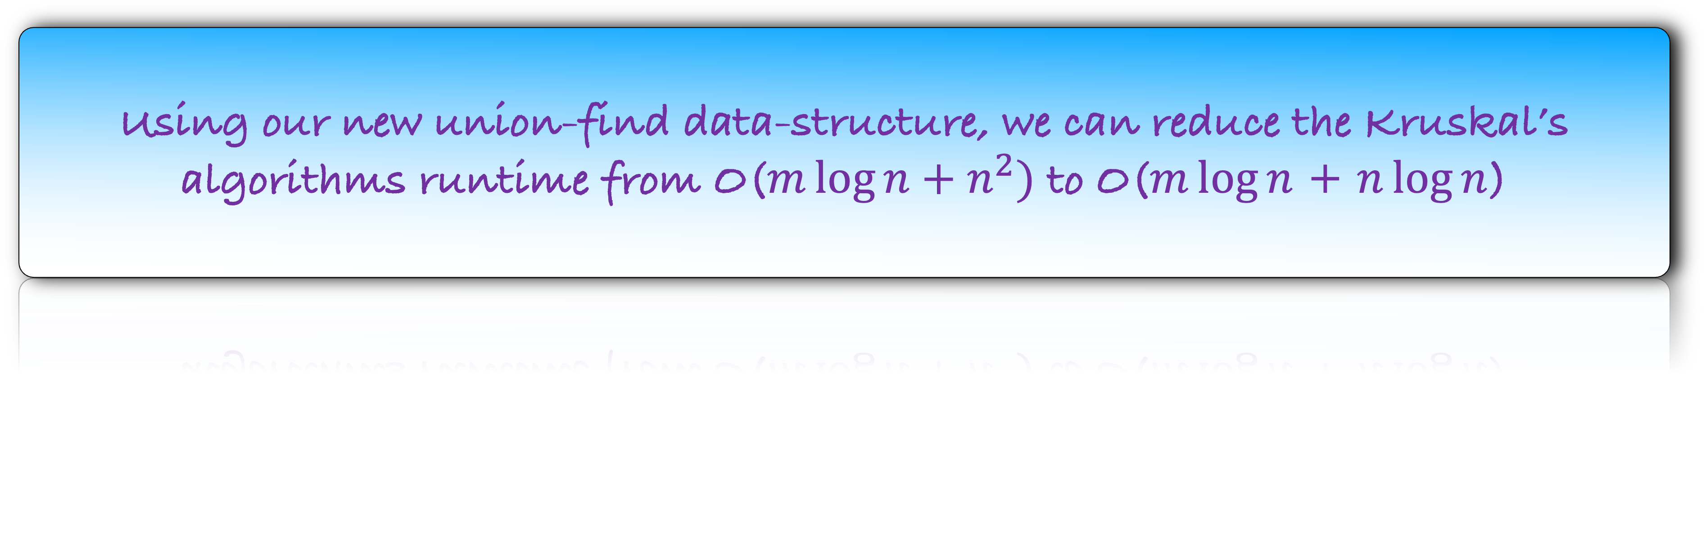

The running time of n-1 union operations
=$∑_{i=1}^{m}$#nodes that change their labels in i-th union operation
=$∑_{v=1}^{n}$#number or times a node v changes its label in n-1 union operations
=$∑_{v=1}^{n}$ $\log{n}$
= $n\log{n}$
Union Find
Union
Find
O($n\log{n}$) over all n-1 union
O($1$) per find
Using our new union-find data-structure, we can reduce the Kruskal’s algorithms runtime from O($m\log{n+n^{2}})$ to O($m\log{n}$ + $n\log{n}$)

Slide 37
Union Find
Union
Find
O($n\log{n}$) over all n-1 union
O($n\log{n}$) over all n-1 union
O($1$) per find
O($1$) per find

Slide 38




Union Find
Union
Find
O($n\log{n}$) over all n-1 union
O($1$) per union
O($1$) per find
O($1$) per find
Can we design an algorithm with constant union time and find?

Slide 39
A Union-Find Algorithm Based on Ranks

Slide 40
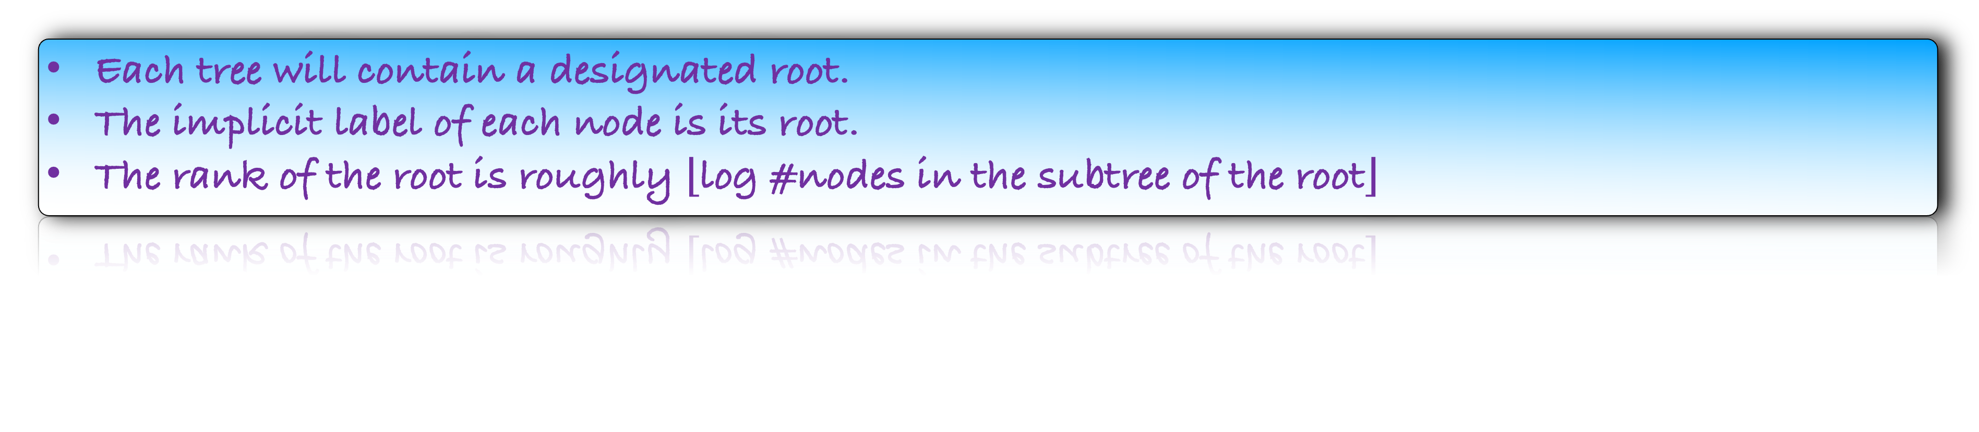
Each tree will contain a designated root.
The implicit label of each node is its root.
The rank of the root is roughly $⌊$log #nodes in the subtree of the root$⌋$
4
0
1
1
1
0
Root
Non-Root
2
Rank of the root
0
6
0
5
0
3
0

Slide 41
4
0
1
What should you do in union(1,2)?
1
1
0
Make 2 the child of 1
2
0
6
0
5
0
3
0
Root
Non-Root
Rank of the root

Slide 42
4
0
1
What should you do in union(1,2)?
1
1
1
Make 2 the child of 1
2
0
6
0
5
0
3
0
Root
Non-Root
Rank of the root

Slide 43
4
0
What should you do in union(4,6)?
1
1
1
1
Make 6 the child of 4
2
0
6
0
5
0
3
0
Root
Non-Root
Rank of the root

Slide 44
4
1
What should you do in union(4,6)?
1
1
1
1
Make 6 the child of 4
2
0
6
0
5
0
3
0
Root
Non-Root
Rank of the root

Slide 45
4
1
What should you do in union(2,6)?
1
1
1
1
Node 1 is the root of the tree containing 2
Node 4 is the root of the tree containing 6
2
0
Make 4 the child of 1
6
0
5
0
3
0
Root
Non-Root
Rank of the root

Slide 46
What should you do in union(2,6)?
1
1
1
2
4
1
Node 1 is the root of the tree containing 2
Node 4 is the root of the tree containing 6
2
0
Make 4 the child of 1
5
0
3
0
6
0
Root
Non-Root
Rank of the root

Slide 47
1
What is find(6)?
1
1
1
2
The root of the tree containing 6
4
1
2
0
5
0
3
0
6
0
Root
Non-Root
Rank of the root

Slide 48
1
What is find(6)?
1
1
1
2
The root of the tree containing 6
4
1
2
0
5
0
3
0
6
0
Root
Non-Root
Rank of the root

Slide 49
1
What is find(6)?
1
1
1
2
The root of the tree containing 6
4
1
2
0
5
0
3
0
6
0
Root
Non-Root
Rank of the root

Slide 50
1
What is find(6)?
1
1
1
2
The root of the tree containing 6
4
1
2
0
5
0
3
0
6
0
Root
Non-Root
Rank of the root

Slide 51
Implementation of Union-Find by Rank

Slide 52
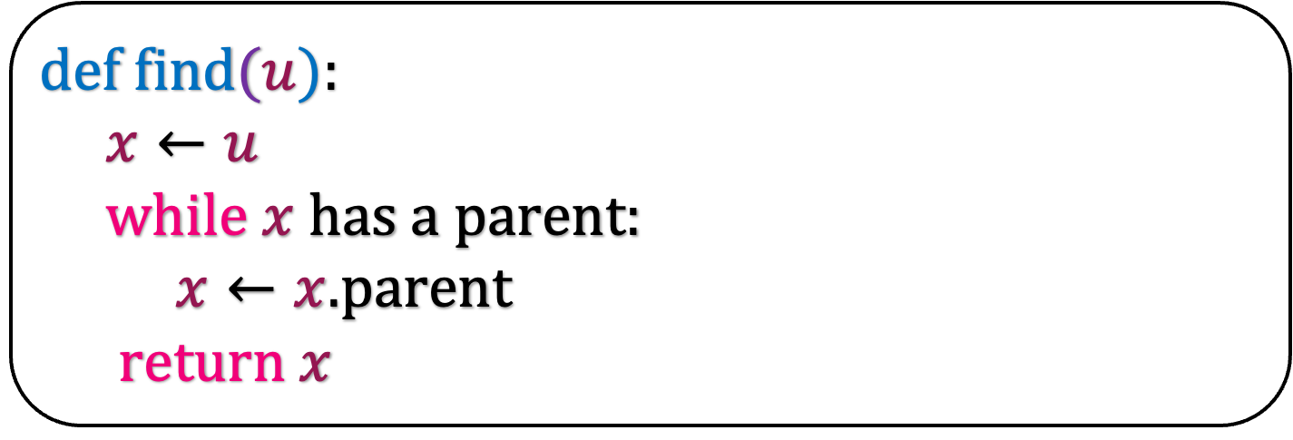
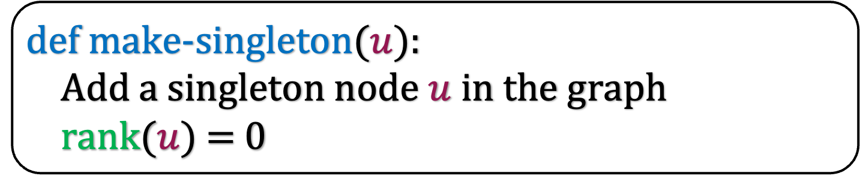
def make-singleton($u$):
Add a singleton node $u$ in the graph
rank$(u)$ = 0
def find$(u$):
$x←u$
while $x$ has a parent:
$x←x.$parent
return $x$

Slide 53

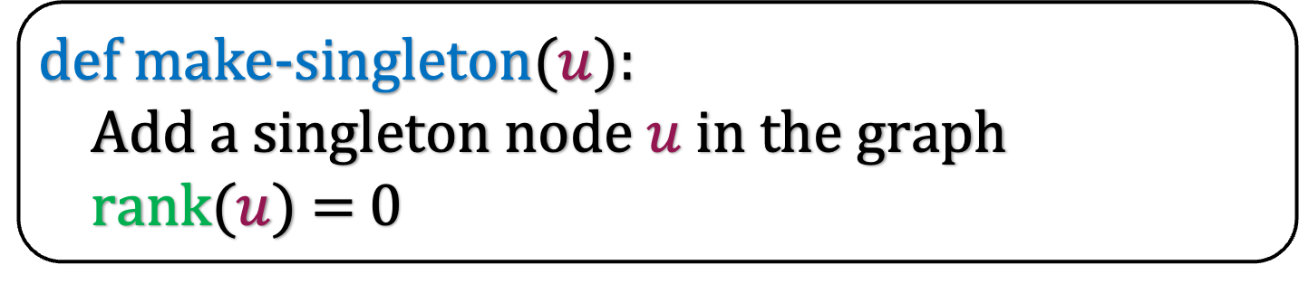
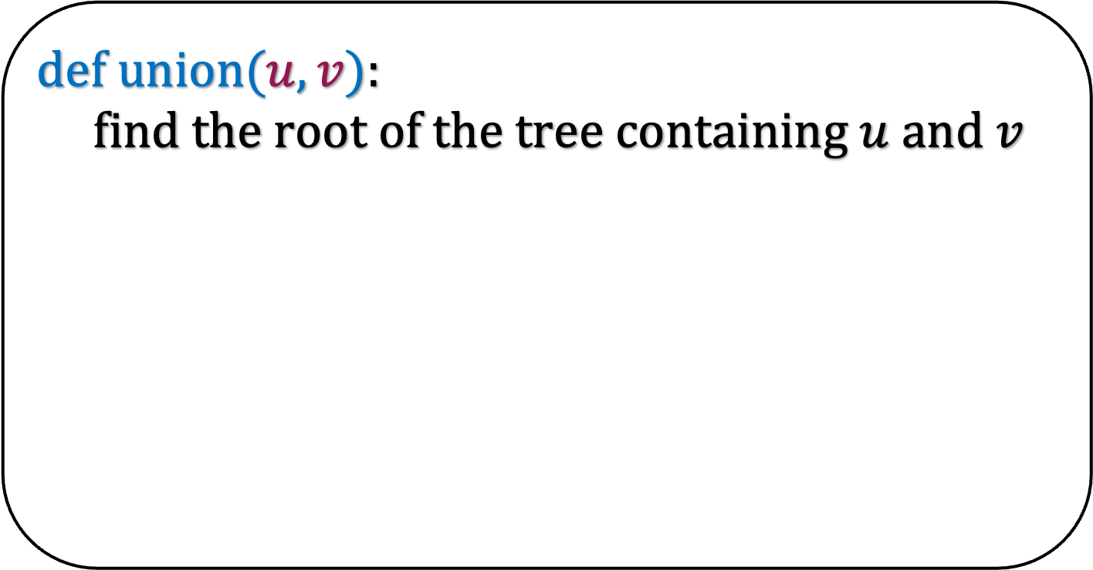
4
1
def make-singleton($u$):
Add a singleton node $u$ in the graph
rank$(u)$ = 0
1
1
1
1
def find$(u$):
$x←u$
while $x$ has a parent:
$x←x.$parent
return $x$
2
0
def u$nion(u,v$):
find the root of the tree containing $u$ and $v$
6
5
0
3
0

Slide 54
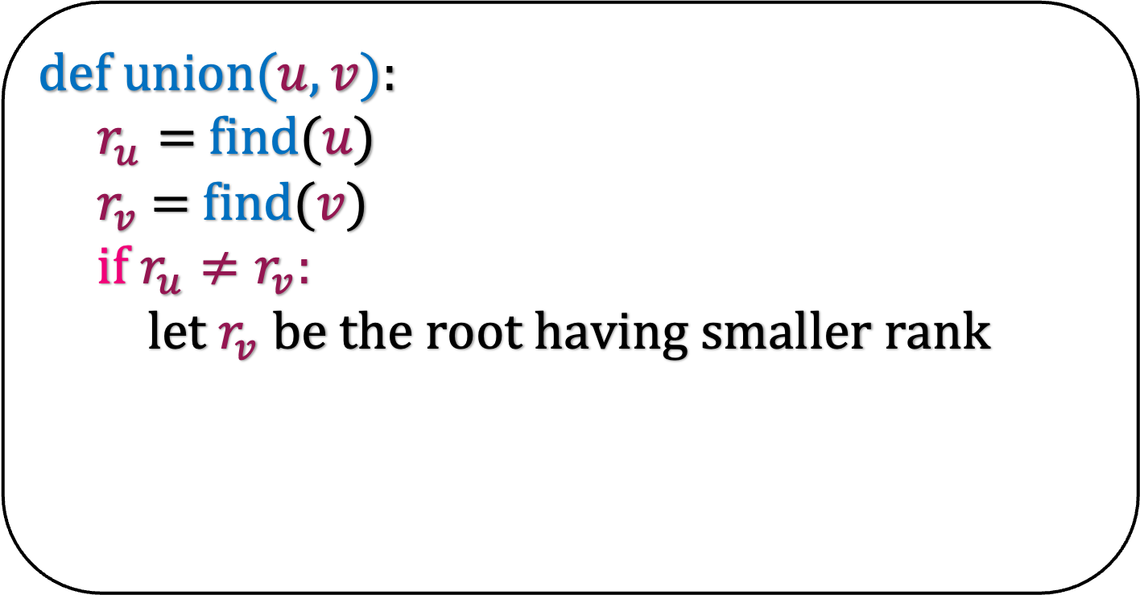
4
1
def make-singleton($u$):
Add a singleton node $u$ in the graph
rank$(u)$ = 0
1
1
1
1
def find$(u$):
$x←u$
while $x$ has a parent:
$x←x.$parent
return $x$
2
0
def u$nion(u,v$):
$r_{u}=$find($u$)
$r_{v}$ = find($v$)
if $r_{u}≠r_{v}:$
let $r_{v}$ be the root having smaller rank
6
5
0
3
0

Slide 55
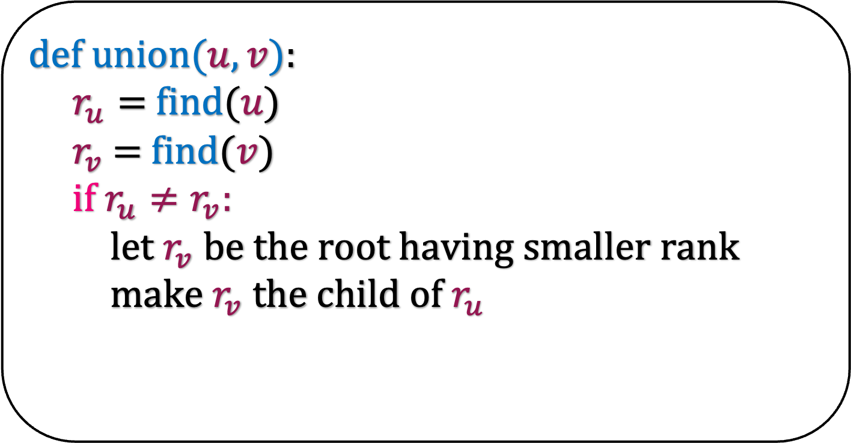
def make-singleton($u$):
Add a singleton node $u$ in the graph
rank$(u)$ = 0
1
1
1
1
def find$(u$):
$x←u$
while $x$ has a parent:
$x←x.$parent
return $x$
4
1
2
0
def u$nion(u,v$):
$r_{u}=$find($u$)
$r_{v}$ = find($v$)
if $r_{u}≠r_{v}:$
let $r_{v}$ be the root having smaller rank
make $r_{v}$ the child of $r_{u}$
5
0
3
0
6

Slide 56
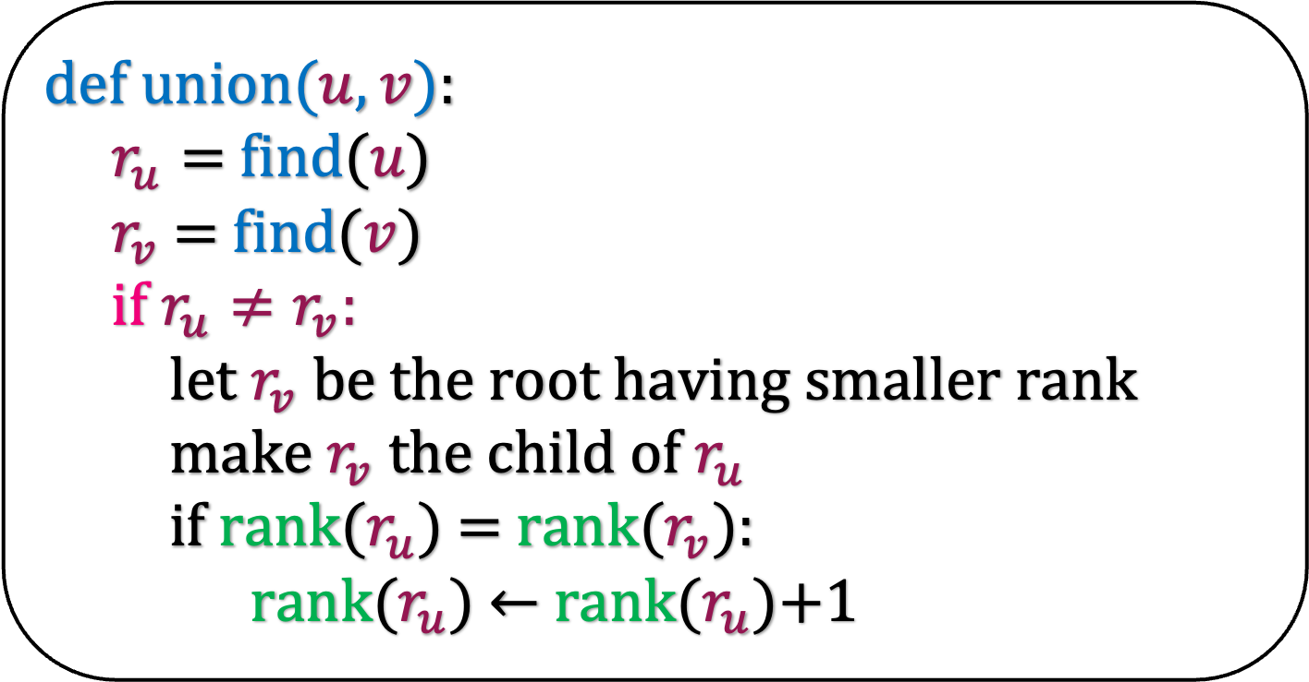
def make-singleton($u$):
Add a singleton node $u$ in the graph
rank$(u)$ = 0
1
1
1
2
def find$(u$):
$x←u$
while $x$ has a parent:
$x←x.$parent
return $x$
4
1
2
0
def u$nion(u,v$):
$r_{u}=$find($u$)
$r_{v}$ = find($v$)
if $r_{u}≠r_{v}:$
let $r_{v}$ be the root having smaller rank
make $r_{v}$ the child of $r_{u}$
if rank($r_{u}$) $=$ rank($r_{v}$):
rank($r_{u}$) $←$ rank($r_{u}$)+1
5
0
3
0
6

Slide 57
Some Observations
def make-singleton($u$):
Add a singleton node $u$ in the graph
rank$(u)$ = 0
Once a node becomes a non-root, it
become root again
def find$(u$):
$x←u$
while $x$ has a parent:
$x←x.$parent
return $x$
can
cannot
def u$nion(u,v$):
$r_{u}=$find($u$)
$r_{v}$ = find($v$)
if $r_{u}≠r_{v}:$
let $r_{v}$ be the root having smaller rank
make $r_{v}$ the child of $r_{u}$
if rank($r_{u}$) $=$ rank($r_{v}$):
rank($r_{u}$) $←$ rank($r_{u}$)+1

Slide 58
Some Observations
def make-singleton($u$):
Add a singleton node $u$ in the graph
rank$(u)$ = 0
Once a node becomes a non-root, it
become root again
cannot
def find$(u$):
$x←u$
while $x$ has a parent:
$x←x.$parent
return $x$
def u$nion(u,v$):
$r_{u}=$find($u$)
$r_{v}$ = find($v$)
if $r_{u}≠r_{v}:$
let $r_{v}$ be the root having smaller rank
make $r_{v}$ the child of $r_{u}$
if rank($r_{u}$) $=$ rank($r_{v}$):
rank($r_{u}$) $←$ rank($r_{u}$)+1

Slide 59
Some Observations
def make-singleton($u$):
Add a singleton node $u$ in the graph
rank$(u)$ = 0
Once a node becomes a non-root, it
become root again
cannot
def find$(u$):
$x←u$
while $x$ has a parent:
$x←x.$parent
return $x$
Once a node become non-root, its rank
Increase
def u$nion(u,v$):
$r_{u}=$find($u$)
$r_{v}$ = find($v$)
if $r_{u}≠r_{v}:$
let $r_{v}$ be the root having smaller rank
make $r_{v}$ the child of $r_{u}$
if rank($r_{u}$) $=$ rank($r_{v}$):
rank($r_{u}$) $←$ rank($r_{u}$)+1
can
cannot

Slide 60





Some Observations
def make-singleton($u$):
Add a singleton node $u$ in the graph
rank$(u)$ = 0
Once a node becomes a non-root, it
become root again
cannot
def find$(u$):
$x←u$
while $x$ has a parent:
$x←x.$parent
return $x$
Once a node become non-root, its rank
Increase
cannot
def u$nion(u,v$):
$r_{u}=$find($u$)
$r_{v}$ = find($v$)
if $r_{u}≠r_{v}:$
let $r_{v}$ be the root having smaller rank
make $r_{v}$ the child of $r_{u}$
if rank($r_{u}$) $=$ rank($r_{v}$):
rank($r_{u}$) $←$ rank($r_{u}$)+1
If x is not a root node,
rank(x) rank(x.parent)
$≤$
$$=$$
$≥$
$$<$$
$$>$$

Slide 61
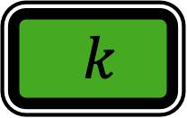


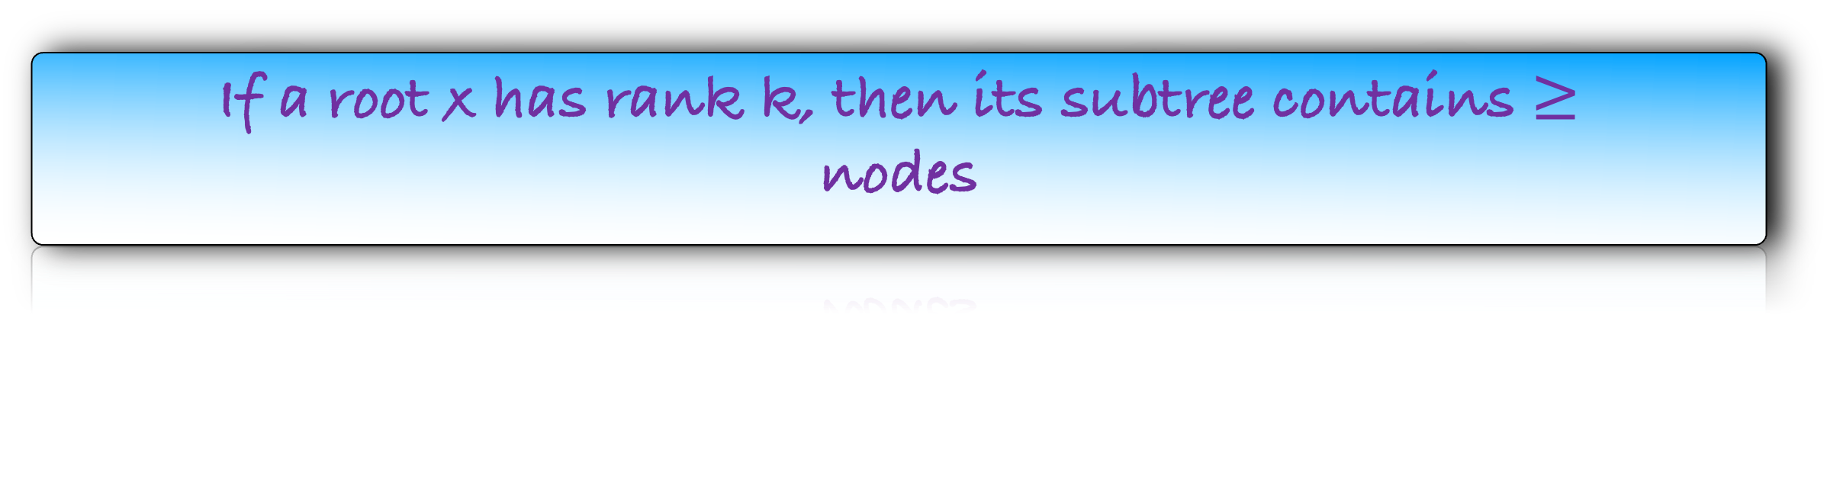
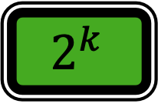


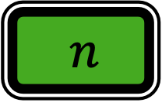
Some Observations
def make-singleton($u$):
Add a singleton node $u$ in the graph
rank$(u)$ = 0
Once a node becomes a non-root, it
become root again
cannot
def find$(u$):
$x←u$
while $x$ has a parent:
$x←x.$parent
return $x$
Once a node become non-root, its rank
Increase
cannot
def u$nion(u,v$):
$r_{u}=$find($u$)
$r_{v}$ = find($v$)
if $r_{u}≠r_{v}:$
let $r_{v}$ be the root having smaller rank
make $r_{v}$ the child of $r_{u}$
if rank($r_{u}$) $=$ rank($r_{v}$):
rank($r_{u}$) $←$ rank($r_{u}$)+1
If x is not a root node,
rank(x) rank(x.parent)
$$<$$
If a root x has rank k, then its subtree contains $≥$
nodes
$k$
$$n$$
$\log{k}$
$$2^{k}$$
$$??$$

Slide 62
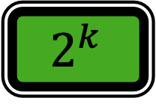
Some Observations
def make-singleton($u$):
Add a singleton node $u$ in the graph
rank$(u)$ = 0
Once a node becomes a non-root, it
become root again
cannot
def find$(u$):
$x←u$
while $x$ has a parent:
$x←x.$parent
return $x$
Once a node become non-root, its rank
Increase
cannot
def u$nion(u,v$):
$r_{u}=$find($u$)
$r_{v}$ = find($v$)
if $r_{u}≠r_{v}:$
let $r_{v}$ be the root having smaller rank
make $r_{v}$ the child of $r_{u}$
if rank($r_{u}$) $=$ rank($r_{v}$):
rank($r_{u}$) $←$ rank($r_{u}$)+1
If x is not a root node,
rank(x) rank(x.parent)
$$<$$
If a root x has rank k, then its subtree contains $≥$
nodes
$$2^{k}$$

Slide 63

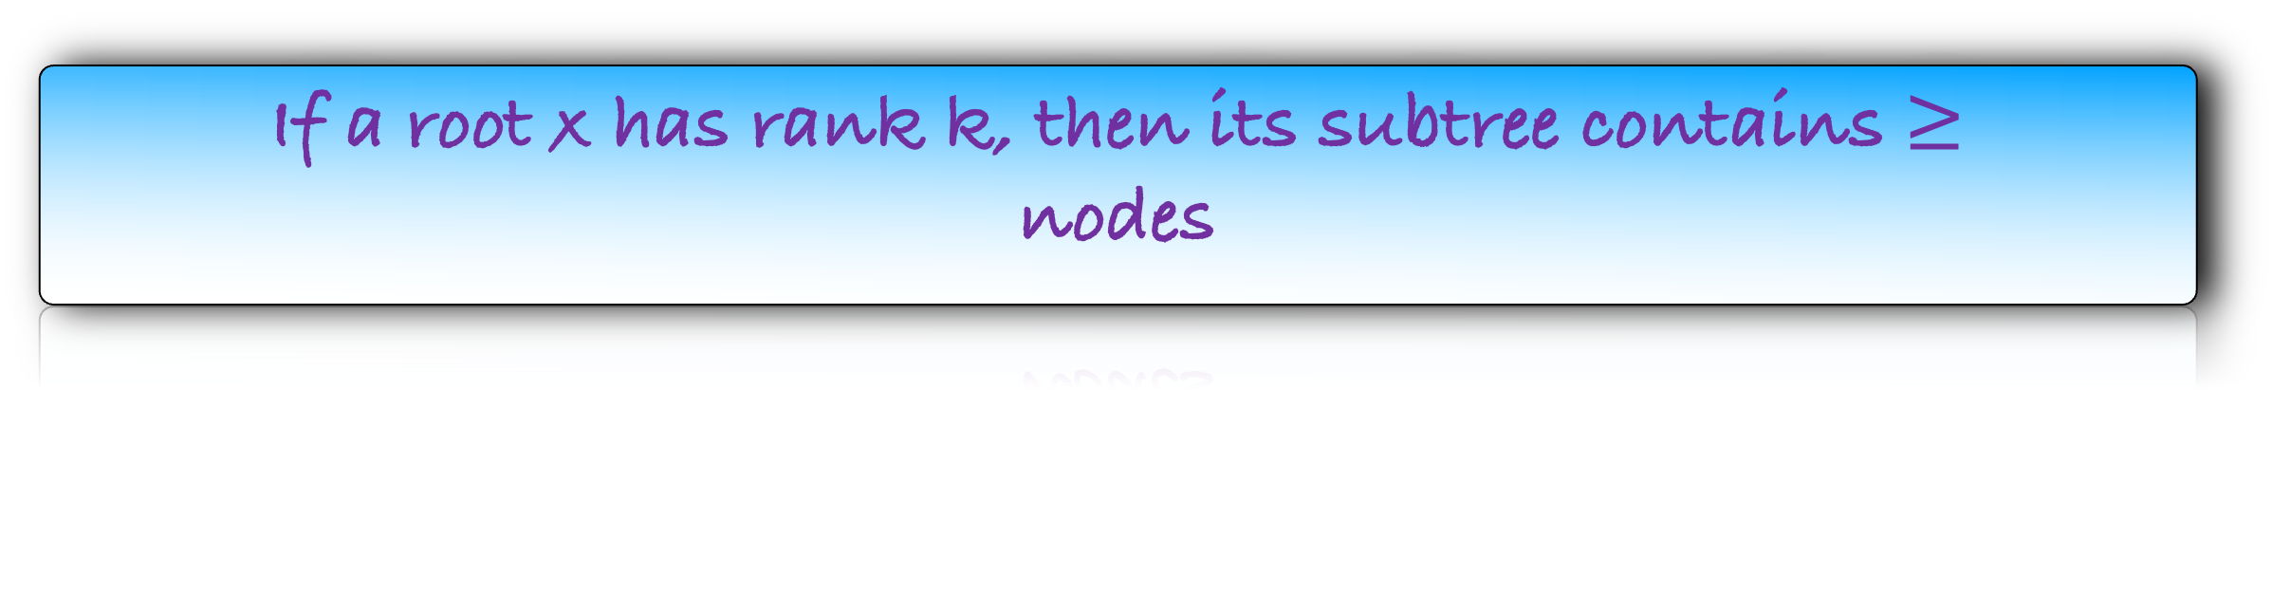


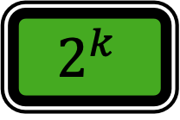
If a root x has rank k, then its subtree contains $≥$
nodes
$$2^{k}$$
x
k-1
Proof by induction on k.
When k=0, there is only one vertex in the subtree of x, that is x itself. So, the base case is true.
Let us assume that the induction hypotheseis is true for 1,2,3,…,k-1
Consider the union operation, when we increase the rank(x) to k.
y
k-1

Slide 64
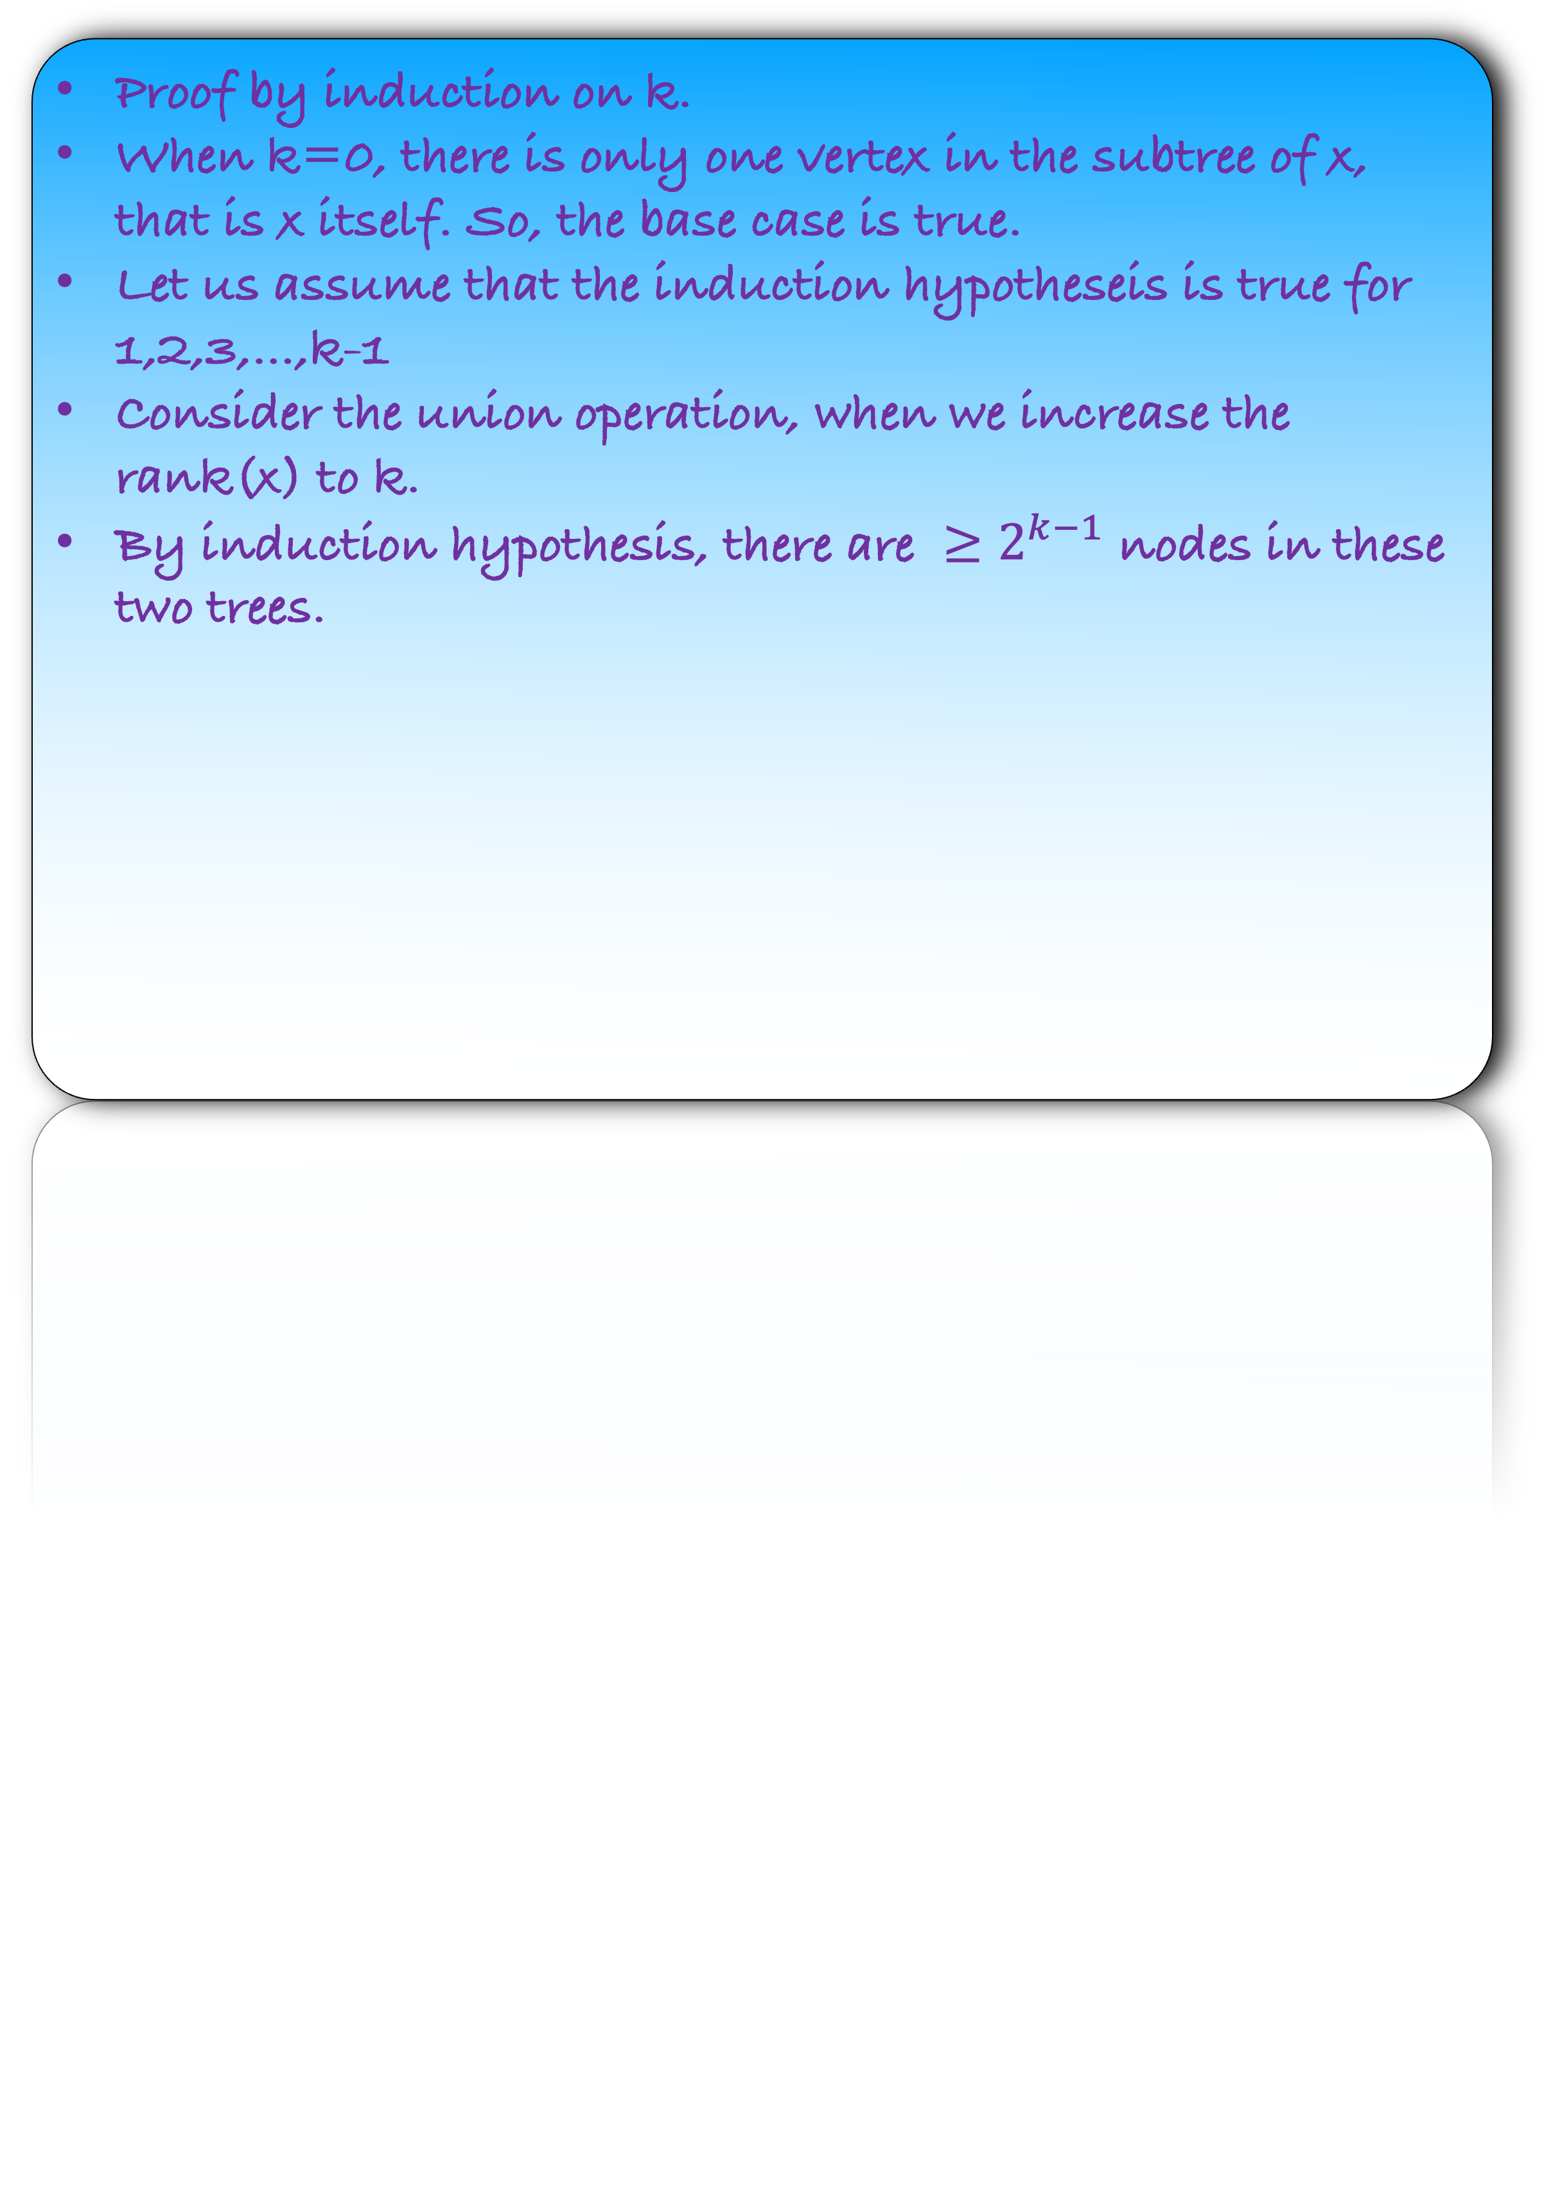
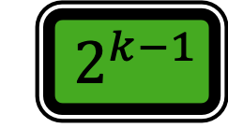
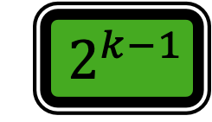
If a root x has rank k, then its subtree contains $≥$
nodes
$$2^{k}$$
x
k-1
Proof by induction on k.
When k=0, there is only one vertex in the subtree of x, that is x itself. So, the base case is true.
Let us assume that the induction hypotheseis is true for 1,2,3,…,k-1
Consider the union operation, when we increase the rank(x) to k.
By induction hypothesis, there are ${≥2}^{k−1}$ nodes in these two trees.
y
k-1
$${ 2}^{k−1}$$
$${ 2}^{k−1}$$

Slide 65
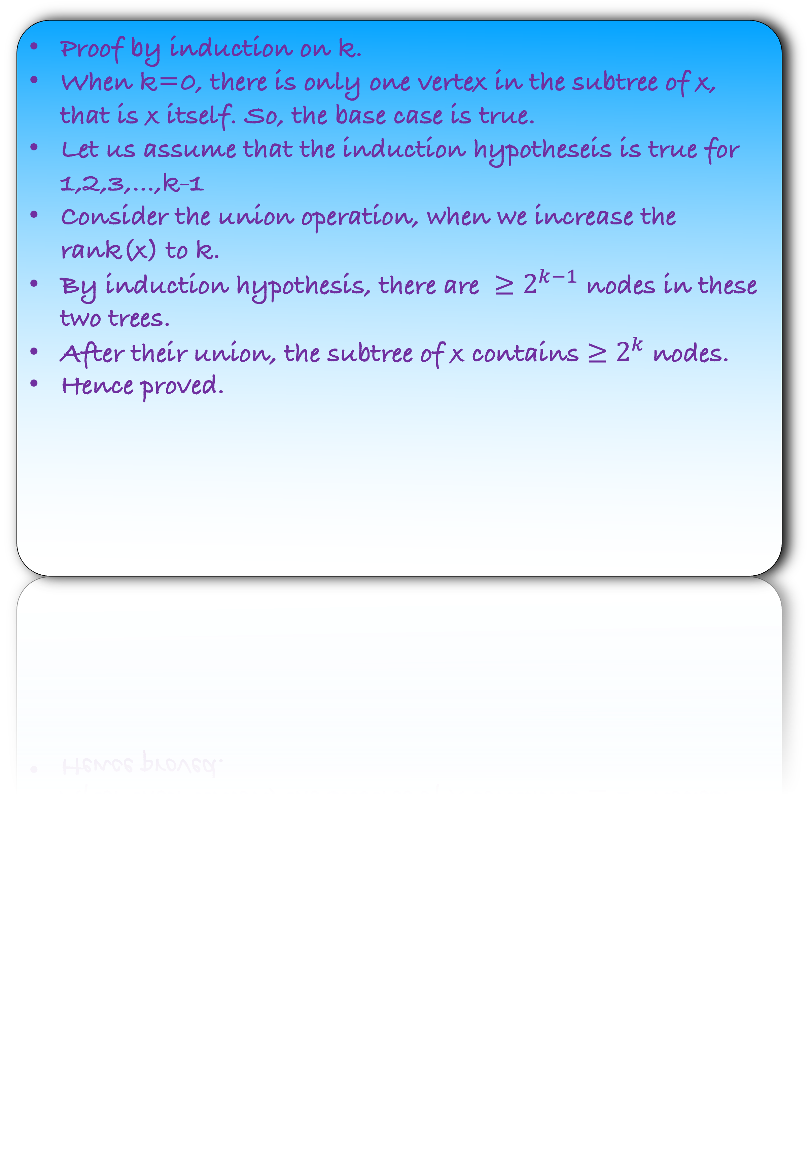

If a root x has rank k, then its subtree contains $≥$
nodes
$$2^{k}$$
x
k
Proof by induction on k.
When k=0, there is only one vertex in the subtree of x, that is x itself. So, the base case is true.
Let us assume that the induction hypotheseis is true for 1,2,3,…,k-1
Consider the union operation, when we increase the rank(x) to k.
By induction hypothesis, there are ${≥2}^{k−1}$ nodes in these two trees.
After their union, the subtree of x contains $≥2^{k}$ nodes.
Hence proved.
y
k-1
$${ 2}^{k}$$

Slide 66
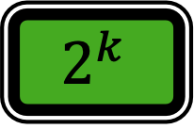

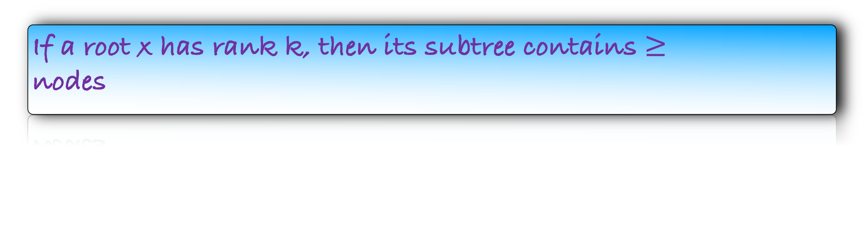

Some Observations
def make-singleton($u$):
Add a singleton node $u$ in the graph
rank$(u)$ = 0
Once a node becomes a non-root, it become root again
cannot
def find$(u$):
$x←u$
while $x$ has a parent:
$x←x.$parent
return $x$
Once a node become non-root, its rank increase
cannot
If x is not a root node, rank(x) rank(x.parent)
$$<$$
If a root x has rank k, then its subtree contains $≥$
nodes
$$2^{k}$$
def u$nion(u,v$):
$r_{u}=$find($u$)
$r_{v}$ = find($v$)
if $r_{u}≠r_{v}:$
let $r_{v}$ be the root having smaller rank
make $r_{v}$ the child of $r_{u}$
if rank($r_{u}$) $=$ rank($r_{v}$):
rank($r_{u}$) $←$ rank($r_{u}$)+1

Slide 67

Some Observations
def make-singleton($u$):
Add a singleton node $u$ in the graph
rank$(u)$ = 0
Once a node becomes a non-root, it become root again
cannot
def find$(u$):
$x←u$
while $x$ has a parent:
$x←x.$parent
return $x$
Once a node become non-root, its rank increase
cannot
If x is not a root node, rank(x) rank(x.parent)
$$<$$
If a root x has rank k, then its subtree contains $≥$
nodes
$$2^{k}$$
def u$nion(u,v$):
$r_{u}=$find($u$)
$r_{v}$ = find($v$)
if $r_{u}≠r_{v}:$
let $r_{v}$ be the root having smaller rank
make $r_{v}$ the child of $r_{u}$
if rank($r_{u}$) $=$ rank($r_{v}$):
rank($r_{u}$) $←$ rank($r_{u}$)+1
Maximum rank of a root is
$$\log{n}$$
What is the running time of find(u)?

Slide 68

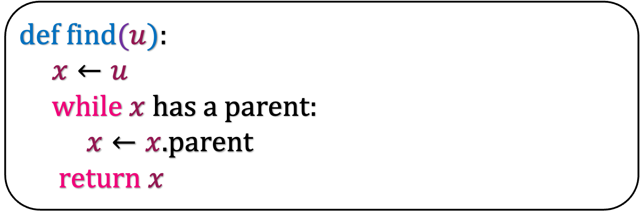


Some Observations
def find$(u$):
$x←u$
while $x$ has a parent:
$x←x.$parent
return $x$
Once a node becomes a non-root, it become root again
cannot
Once a node become non-root, its rank increase
cannot
1
1
a
??
If x is not a root node, rank(x) rank(x.parent)
$$<$$
b
??
If a root x has rank k, then its subtree contains $≥$
nodes
$$2^{k}$$
c
??
Maximum rank of a root is
$$\log{n}$$
d
??
e
??
u
$ℓ$

Slide 69

Some Observations
def find$(u$):
$x←u$
while $x$ has a parent:
$x←x.$parent
return $x$
Once a node becomes a non-root, it become root again
cannot
Once a node become non-root, its rank increase
cannot
1
1
a
??
If x is not a root node, rank(x) rank(x.parent)
$$<$$
b
??
If a root x has rank k, then its subtree contains $≥$
nodes
$$2^{k}$$
c
??
Maximum rank of a root is
$$\log{n}$$
d
??
e
$≥ℓ+1$
u
$ℓ$

Slide 70




Some Observations
def find$(u$):
$x←u$
while $x$ has a parent:
$x←x.$parent
return $x$
Once a node becomes a non-root, it become root again
cannot
Once a node become non-root, its rank increase
cannot
1
1
a
$≥ℓ+5$
If x is not a root node, rank(x) rank(x.parent)
$$<$$
b
$≥ℓ+4$
If a root x has rank k, then its subtree contains $≥$
nodes
$$2^{k}$$
c
$≥ℓ+3$
Maximum rank of a root is
$$\log{n}$$
d
$≥ℓ+2$
e
$≥ℓ+1$
u
$ℓ$

Slide 71
Some Observations
def find$(u$):
$x←u$
while $x$ has a parent:
$x←x.$parent
return $x$
Once a node becomes a non-root, it become root again
cannot
Once a node become non-root, its rank increase
cannot
1
1
a
$≥ℓ+5$
If x is not a root node, rank(x) rank(x.parent)
$$<$$
b
$≥ℓ+4$
If a root x has rank k, then its subtree contains $≥$
nodes
$$2^{k}$$
c
$≥ℓ+3$
Maximum rank of a root is
$$\log{n}$$
d
$≥ℓ+2$
As we move up, the rank of the vertices increase by at least 1.
But the maximum rank is log n and the minimum rank is 0.
Thus, the path from u to root is at most log n.
Thus, the running time of find is O(log n)
e
$≥ℓ+1$
u
$ℓ$

Slide 72
Some Observations
def make-singleton($u$):
Add a singleton node $u$ in the graph
rank$(u)$ = 0
Once a node becomes a non-root, it become root again
cannot
def find$(u$):
$x←u$
while $x$ has a parent:
$x←x.$parent
return $x$
Once a node become non-root, its rank increase
cannot
If x is not a root node, rank(x) rank(x.parent)
$$<$$
If a root x has rank k, then its subtree contains $≥$
nodes
$$2^{k}$$
def u$nion(u,v$):
$r_{u}=$find($u$)
$r_{v}$ = find($v$)
if $r_{u}≠r_{v}:$
let $r_{v}$ be the root having smaller rank
make $r_{v}$ the child of $r_{u}$
if rank($r_{u}$) $=$ rank($r_{v}$):
rank($r_{u}$) $←$ rank($r_{u}$)+1
Maximum rank of a root is
$$\log{n}$$
What is the running time of union(u)?
Doing find two times.
Thus, the running time of union is O(log n)

Slide 73
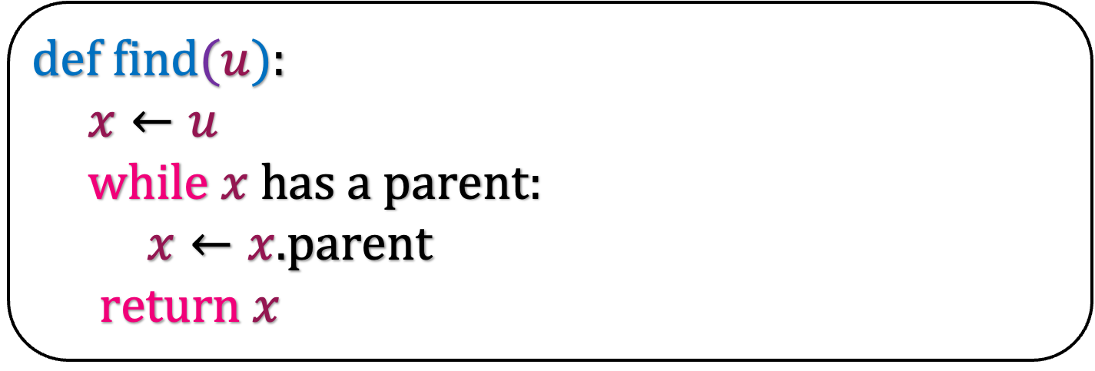



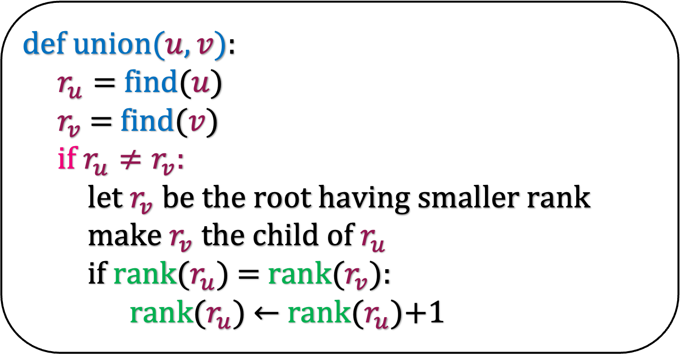
def make-singleton($u$):
Add a singleton node $u$ in the graph
rank$(u)$ = 0
O($1$)
def find$(u$):
$x←u$
while $x$ has a parent:
$x←x.$parent
return $x$
O($\log{n}$)
def u$nion(u,v$):
$r_{u}=$find($u$)
$r_{v}$ = find($v$)
if $r_{u}≠r_{v}:$
let $r_{v}$ be the root having smaller rank
make $r_{v}$ the child of $r_{u}$
if rank($r_{u}$) $=$ rank($r_{v}$):
rank($r_{u}$) $←$ rank($r_{u}$)+1
O($\log{n}$)

Slide 74




Union Find
Union
Find
O($n\log{n}$) over all n-1 union
O($\log{n}$) per union
O($1$) per find
O($\log{n}$) per find
Can we design an algorithm with constant union time and find?

